Slide 1
C++ Course 4 Memory & OOP 2
By cstudio

Slide 2
Summary
Addresses & pointers
Plain arrays
New & delete
RAII
Practise : a FILE* wrapper
The problems with auto_ptr
Rvalue references & std::move
Shared_ptr & unique_ptr
Rule of 5 & rule of 0
Practise : a safer FILE* wrapper
Virtual methods & polymorphism
Abstract classes & virtual destructor
Diamond problem
Virtual inheritance
Practise : Vehicles and Garage

Slide 3
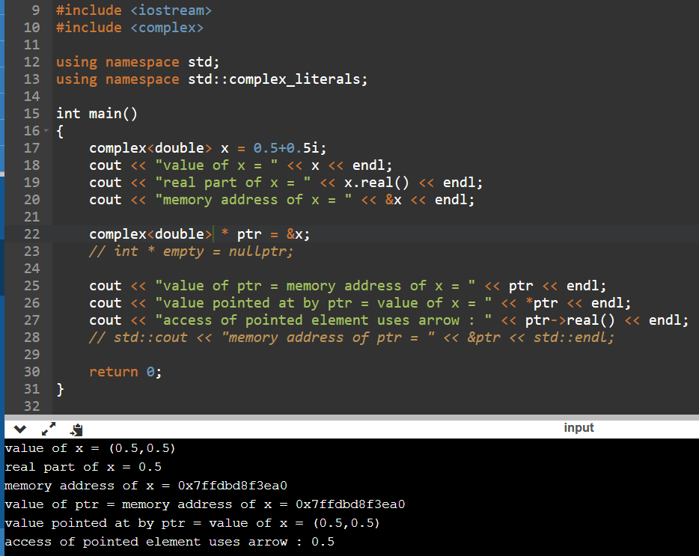
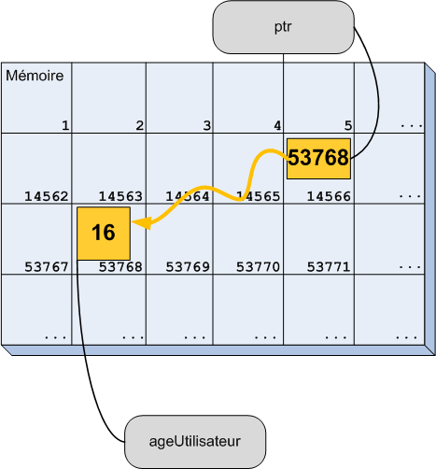
Addresses & pointers

Slide 4
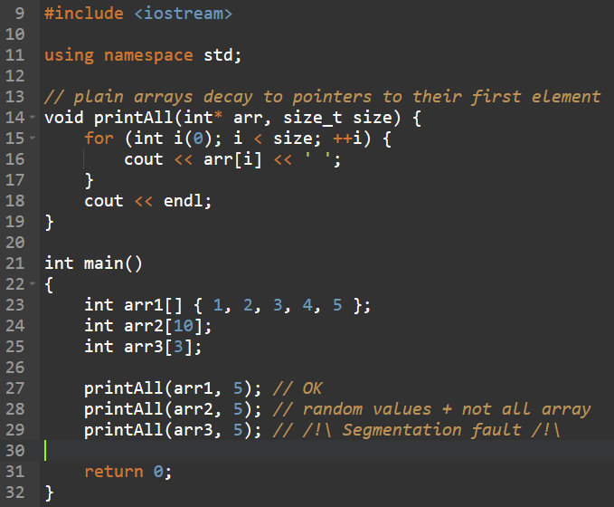
Plain arrays

Slide 5
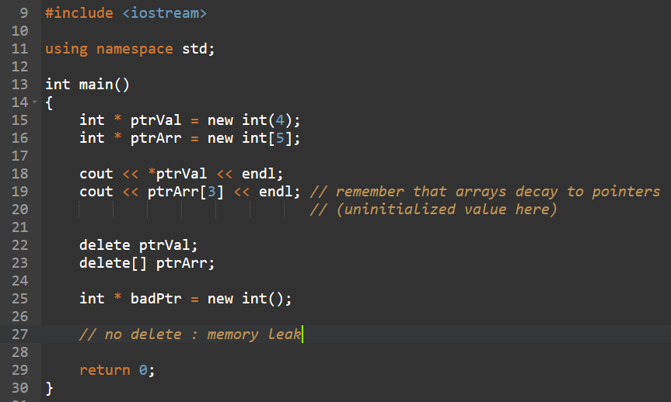
New & Delete

Slide 6
RAII
Resource Acquisition Is Initialization, or as it should have been called, Resource Release Is Destruction
Pairs of function for acquiring & releasing a resource are frequent : new/delete, open/close, lock/unlock…
Problems : easy to forget, exceptions, etc.
Solution : wrap in a class and release in destructor !
But there’s a catch…

Slide 7
Practise : a FILE* wrapper
Sometimes, when you program in C++, you have to use a C library. A good practice to make your code safer is to wrap all the C library’s resource management to C++ classes that implement the RAII design pattern.
Make a CFileWrapper class that wraps a FILE* handle returned by the C fopen() function in its constructor, and closes it appropriately with fclose() in its destructor. Don’t forget to add << and >> operators appropriately !

Slide 8
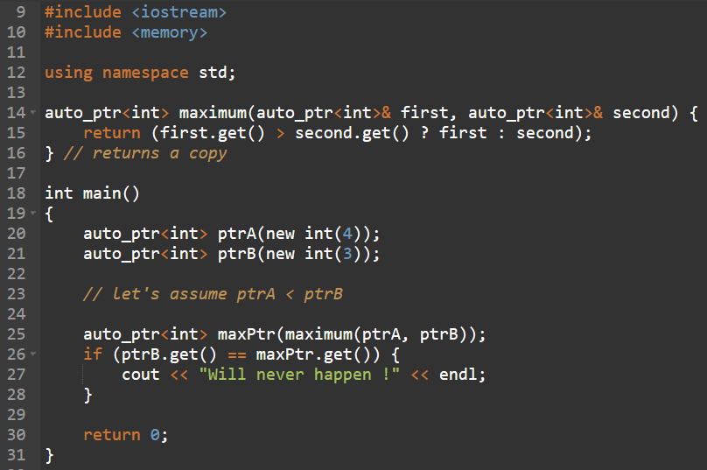
The problem of Auto_ptr

Slide 9
Rvalue references & std::move
We need a way to express “transfer of ownership” distinctively from a copy : introduction of move semantics
In short :
Lvalues = things at the left of an assignment ;
Rvalues = things at the right of an assignment.
Std::move is simply a cast from lvalue to rvalue : it is a way for the programmer to say that the variable is the result of a computation, and that it is about to be stored elsewhere. It doesn’t do anything until a second variable takes ownership of the data inside the first one.
Also used by STL containers !

Slide 10
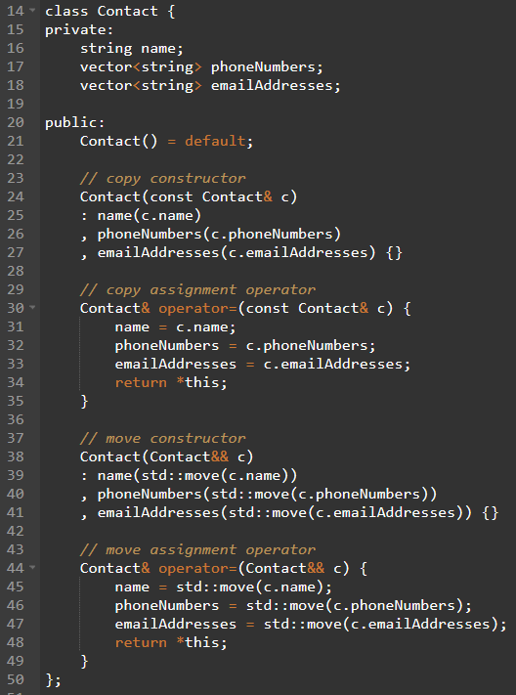
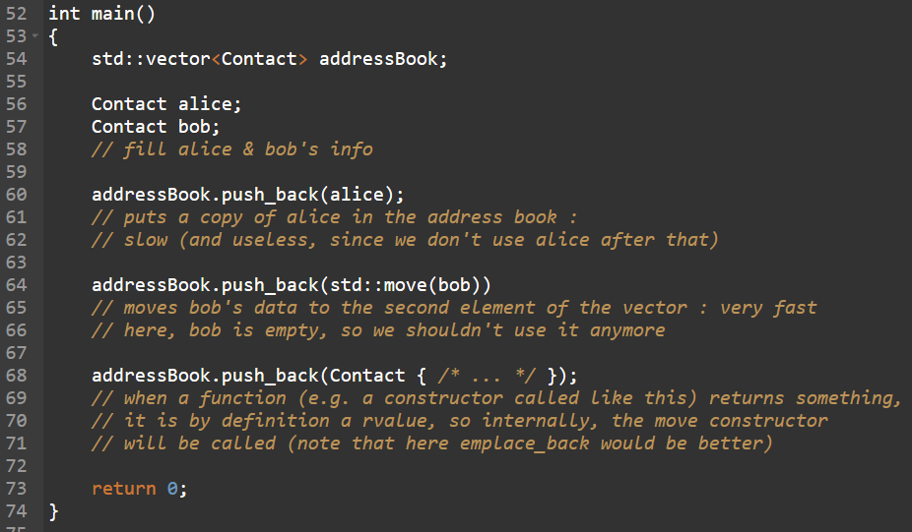
Rvalue references & std::move

Slide 11
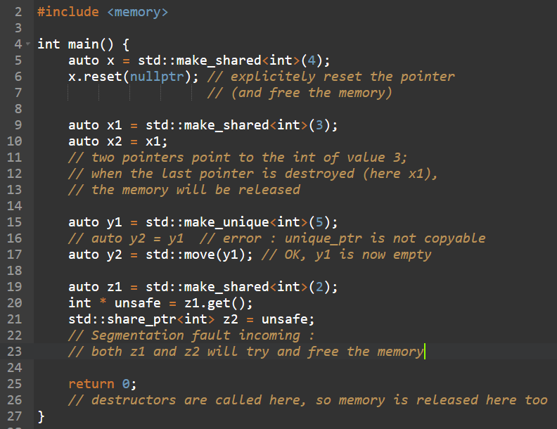
Shared_ptr & unique_ptr

Slide 12
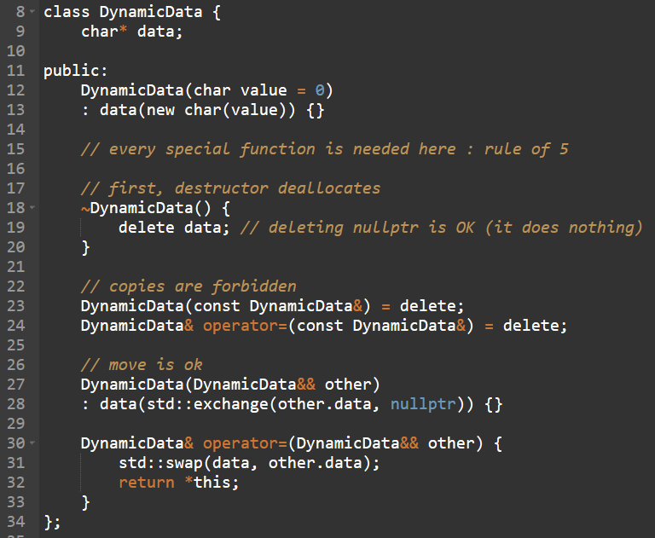
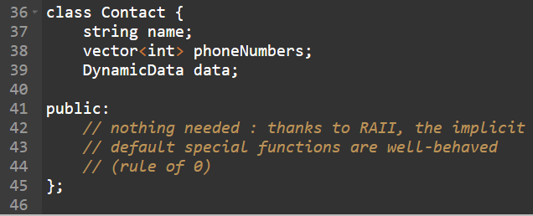
Rule of 5 & rule of 0

Slide 13
Practise : a safer FILE* wrapper
Your CFileWrapper has the same problems as auto_ptr ! Transform it so it resembles unique_ptr more !
When you’re finished, try to make a vector of CFileWrappers and see if your program crashes or not ^^

Slide 14
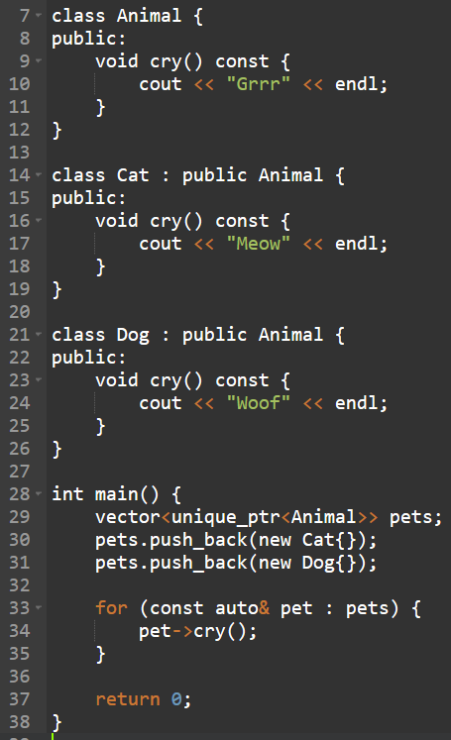
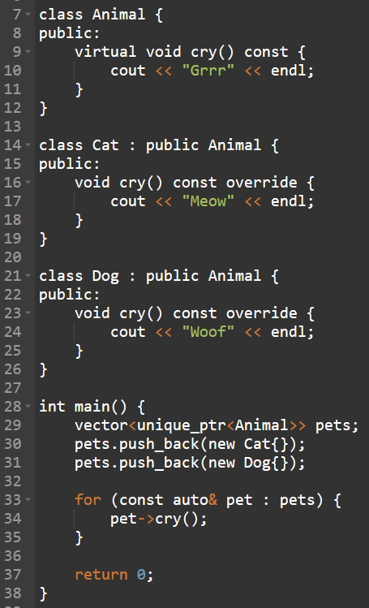
Virtual methods & polymorphism

Slide 15
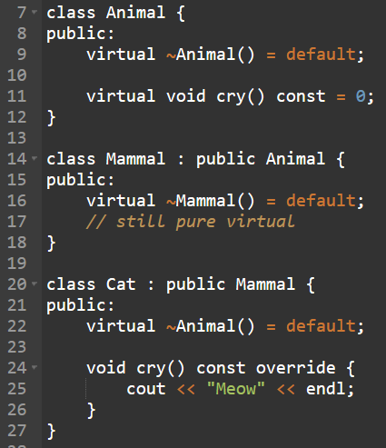
Abstract classes & virtual dtor

Slide 16
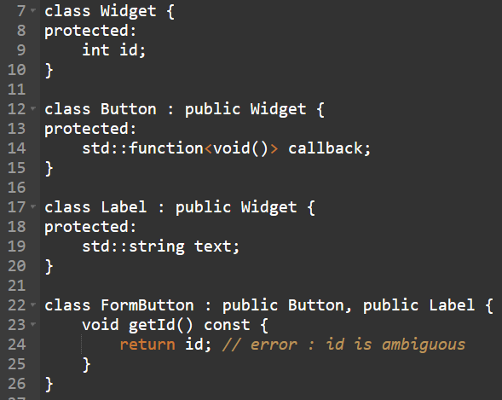
Diamond problem

Slide 17
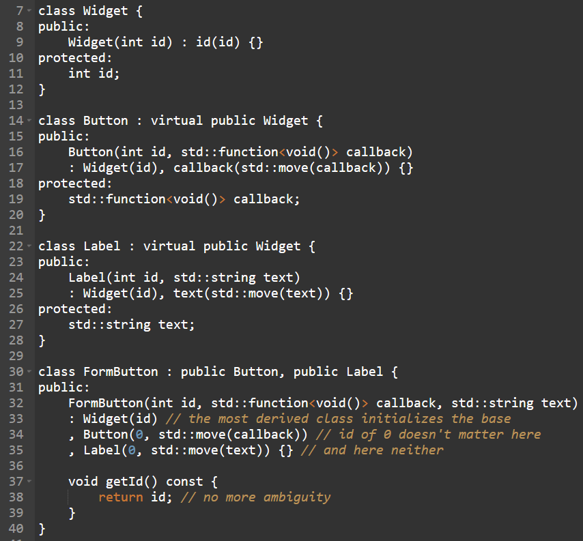
Virtual inheritance

Slide 18
Practise : a Garage of Vehicles
Make a Vehicle abstract class with a model name, a max speed and number of passengers. Make three derived classes, Plane, Boat and Car, with respectively a max altitude, a buoyancy value and a number of wheels.
Then, make three even more derived classes : a Seaplane, an AmphibiousCar and a FlyingCar, each inheriting from two of the classes above.
Finally, make a Garage class that can contain instances of any of the classes above, and print info about them.

